Slide 1
Customer Portal Registration Process V03 June 2018

Slide 2
UK CAA Website – Link to exam registration pages
Link to Flight Crew Licence Exam Registration
http://caa.co.uk/Commercial-industry/Pilot-licences/Applications/Exams/Register-for-a-professional-pilot-exam/
Link to Aircraft Maintenance Licence Exam Registration
http://caa.co.uk/Commercial-industry/Aircraft/Airworthiness/Engineer-licences/Examinations/Aircraft-maintenance-licence-examinations/

Slide 3
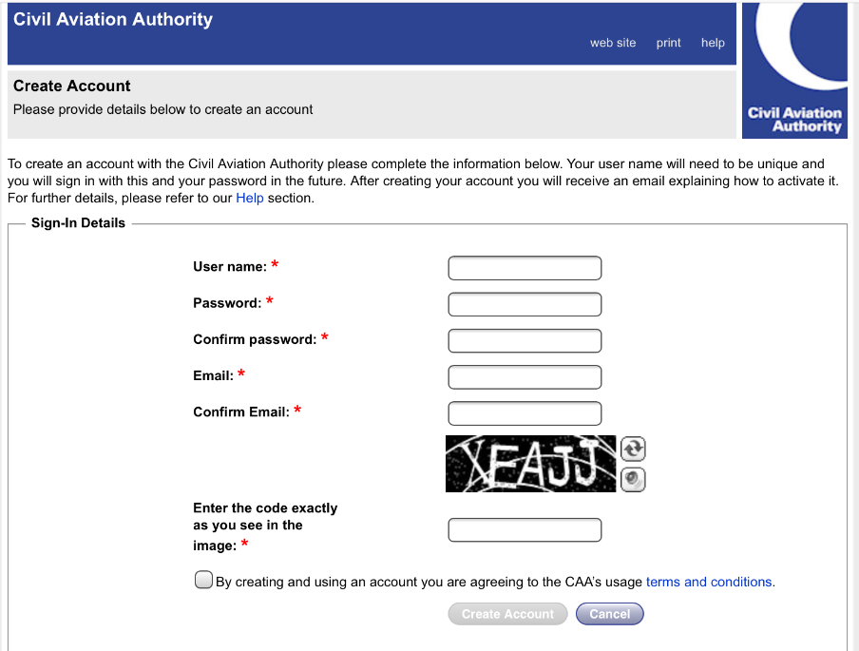
STEP 1: User applies for CAA Customer Portal Account

Slide 4
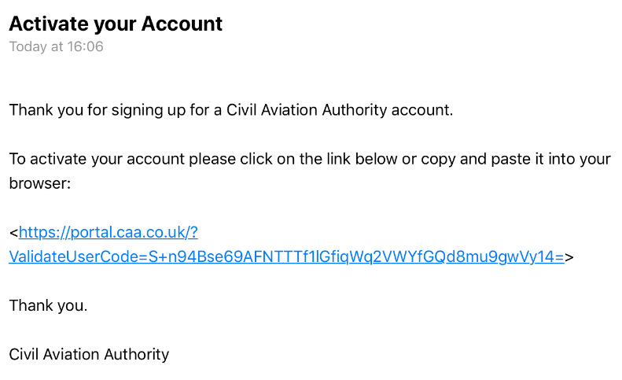
STEP 2: User receives an email to activate account.

Slide 5
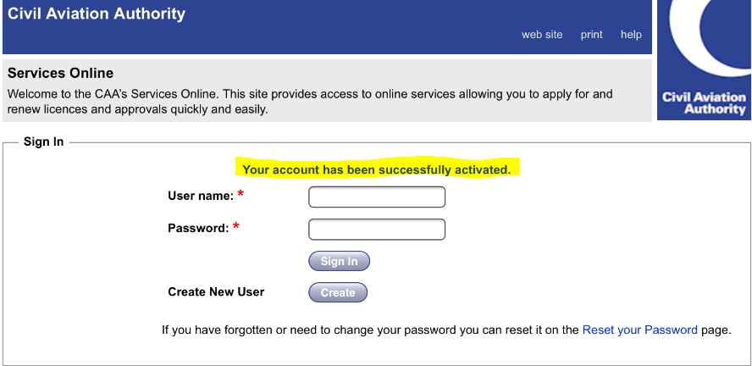
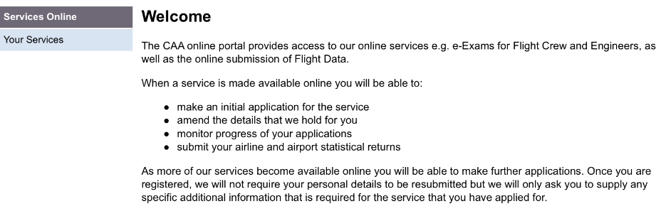
Step 3: Log back into portal to access unverified account.

Slide 6
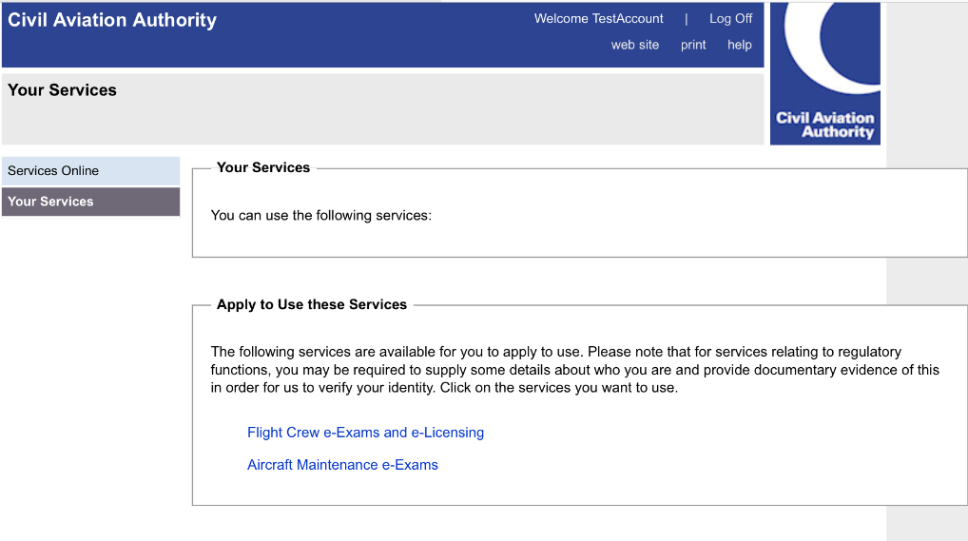
STEP 4: Select the Service that you require……

Slide 7
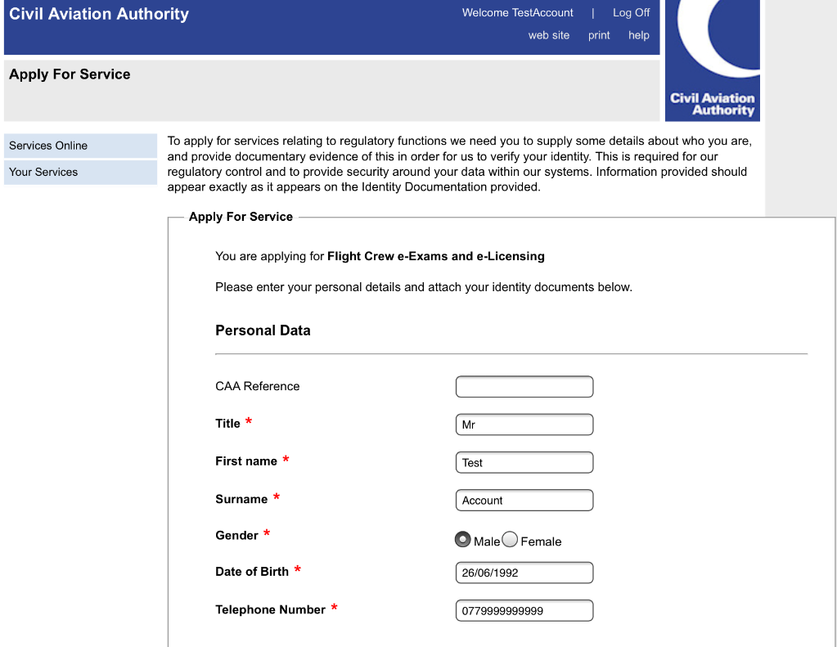
Step 5a: Enter requested Personal Details

Slide 8
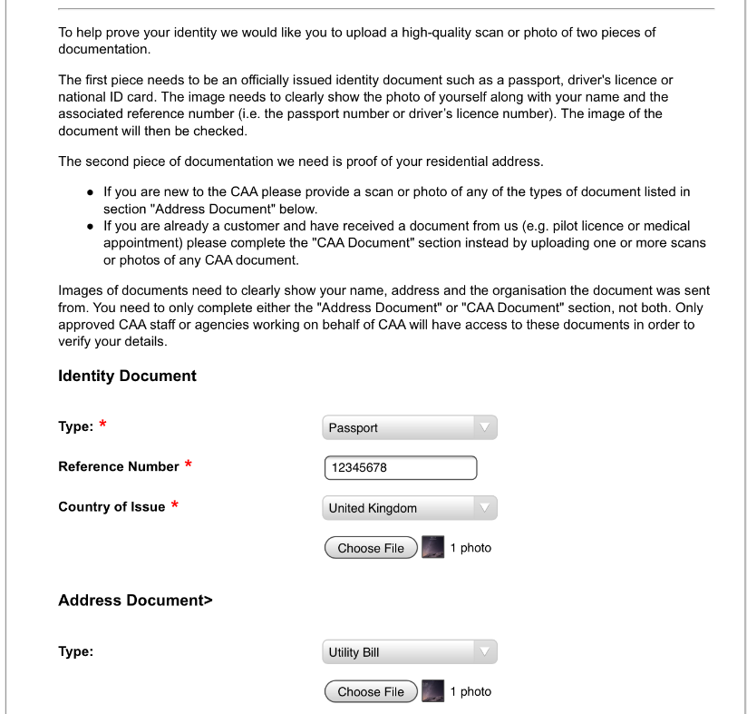
Step 5b: Upload ID Documentation

Slide 9
STEP 6a: System message

Slide 10
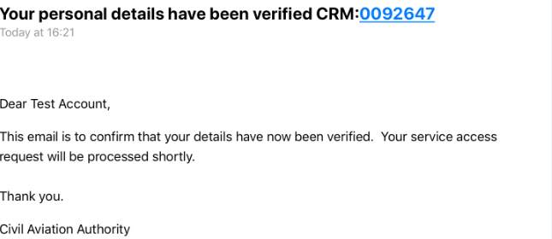
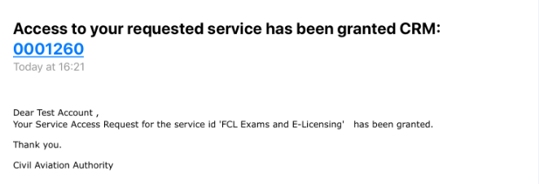
STEP 6b: E-mails to confirm that service is granted….

Slide 11
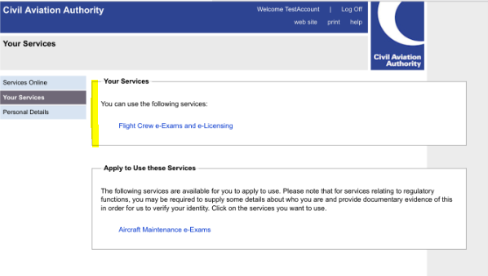
6C : Log into account – Requested service now available in “Your Services”

Slide 12
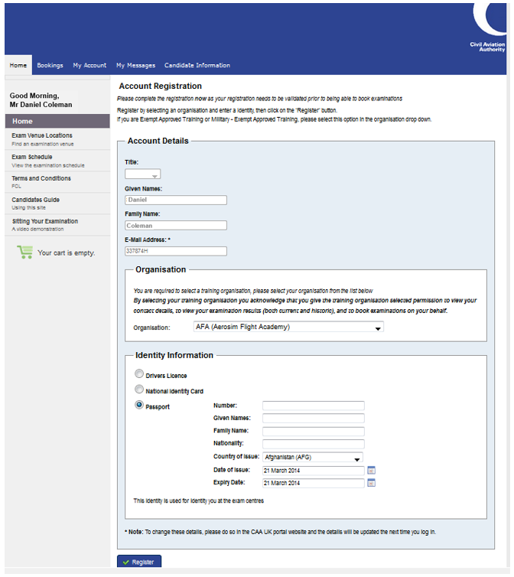
STEP 7: To complete registration ……..
Select Training Organisation option from the drop down list.
Confirm the photo ID document that they will bring to the exam.

Slide 13
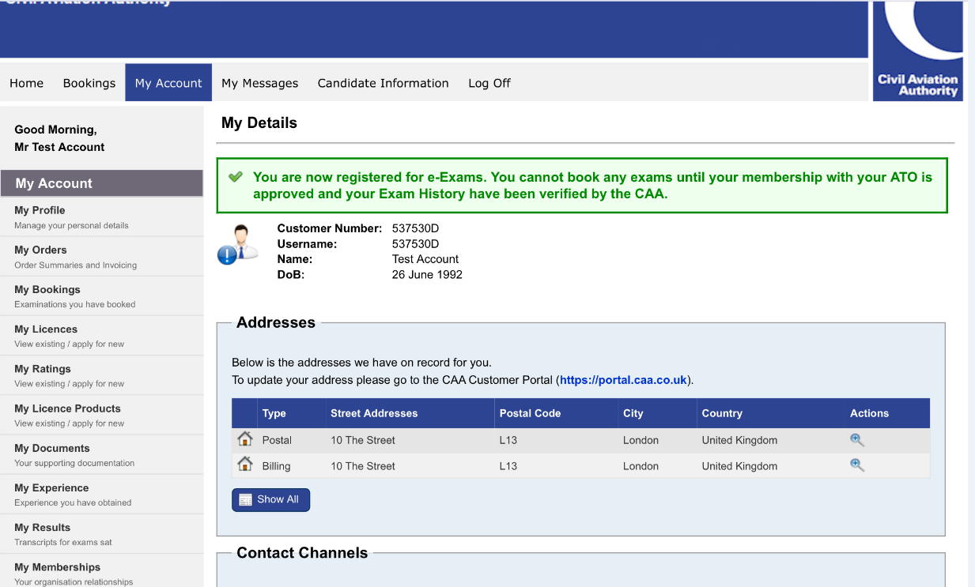
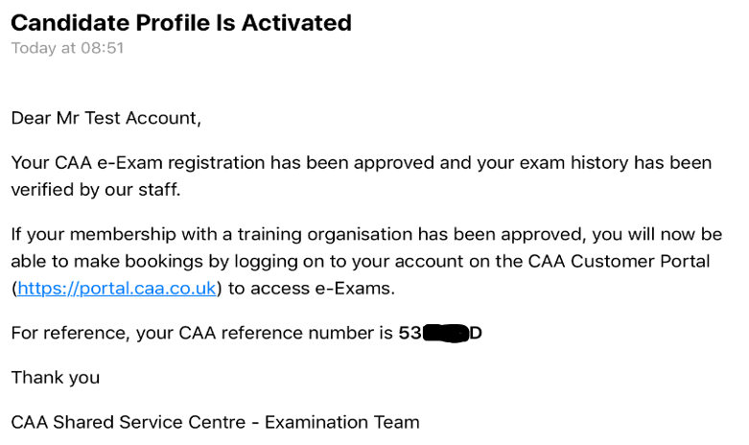
STEP 8: User submits Tasman registration
ATO approves membership in Tasman. Candidate is notified via email CAA validates Tasman account (verifies exam history). Candidate is notified via email.

Slide 14
Registration Complete …..
Any issues ?
Contact
For Flight Crew Exams
FCL-EExams@caa.co.uk
For Aircraft Maintenance Exams
AML-EExams@caa.co.uk

